Slide 1
TELANGANA GROWTH ANALYSIS
FY 2019-2023
Stamp Registration, Transportation, TS-IPASS
Presented by:
Vinay Kumar Parashara Batter

Slide 2
The TOP 5 Districts with the highest document registration revenue growth between FY 2019 and 2022.
dist_code | district | total_document_registration_revenue
15_2 | Medchal_Malkajgiri | ₹ 47,16,31,41,741
16_1 | Hyderabad | ₹ 34,36,08,10,312
15_1 | Rangareddy | ₹ 32,52,45,94,586
17_2 | Sangareddy | ₹ 19,86,39,66,773
21_1 | Hanumakonda | ₹ 7,25,97,24,585

Slide 3
The Top 5 districts with e-stamps revenue contributes significantly more to the revenue than the documents in FY 2022
dist_code | district | total_document_registration_revenue | total_estamps_revenue
21_1 | Hanumakonda | ₹ 2,89,10,14,228 | ₹ 2,91,11,82,033
18_1 | Nizamabad | ₹ 1,45,06,90,033 | ₹ 1,46,16,25,936
22_1 | Khammam | ₹ 2,05,05,46,017 | ₹ 2,07,86,31,953
14_4 | Wanaparthy | ₹ 44,15,97,617 | ₹ 44,32,19,330
14_2 | Jogulamba Gadwal | ₹ 34,55,33,466 | ₹ 34,74,08,639

Slide 4
Categorization of Districts based on their stamp registration revenue generation during the fiscal year 2021 to 2022
dist_code | district | total_estamps_revenue | Revenue_segment
15_2 | Medchal_Malkajgiri | ₹ 30,06,44,01,559 | High Revenue
16_1 | Hyderabad | ₹ 23,90,24,97,868 | High Revenue
17_2 | Sangareddy | ₹ 14,32,08,90,271 | High Revenue
21_1 | Hanumakonda | ₹ 4,93,04,53,019 | High Revenue
22_1 | Khammam | ₹ 3,65,23,73,063 | High Revenue
23_3 | Yadadri Bhuvanagiri | ₹ 3,52,06,79,984 | High Revenue
18_1 | Nizamabad | ₹ 2,61,91,72,847 | Medium Revenue
23_1 | Nalgonda | ₹ 2,61,59,91,115 | Medium Revenue
20_1 | Karimnagar | ₹ 2,54,33,93,729 | Medium Revenue
15_1 | Rangareddy | ₹ 2,49,13,91,942 | Medium Revenue
14_1 | Mahabubnagar | ₹ 1,95,63,97,969 | Medium Revenue
23_2 | Suryapet | ₹ 1,79,28,92,947 | Medium Revenue
17_3 | Siddipet | ₹ 1,63,77,65,232 | Medium Revenue
20_4 | Peddapalli | ₹ 1,10,53,63,908 | Medium Revenue
17_1 | Medak | ₹ 1,07,37,20,325 | Medium Revenue
19_3 | Mancherial | ₹ 1,06,57,62,897 | Medium Revenue
20_2 | Jagtial | ₹ 1,01,58,54,651 | Medium Revenue
15_3 | Vikarabad | ₹ 86,18,77,771 | Low Revenue
14_3 | Nagarkurnool | ₹ 84,93,87,306 | Low Revenue
18_2 | Kamareddy | ₹ 84,21,52,448 | Low Revenue
21_3 | Jangoan | ₹ 70,67,01,596 | Low Revenue
20_3 | Rajanna Sircilla | ₹ 69,67,45,057 | Low Revenue
14_4 | Wanaparthy | ₹ 69,61,78,925 | Low Revenue
19_1 | Adilabad | ₹ 69,35,56,767 | Low Revenue
21_5 | Mahabubabad | ₹ 67,62,93,913 | Low Revenue
14_2 | Jogulamba Gadwal | ₹ 61,38,31,979 | Low Revenue
19_2 | Nirmal | ₹ 60,74,42,237 | Low Revenue
22_2 | Bhadradri Kothagudem | ₹ 53,25,48,442 | Low Revenue
14_5 | Narayanpet | ₹ 45,25,92,565 | Low Revenue
21_2 | Warangal | ₹ 41,50,47,454 | Low Revenue
21_6 | Mulugu | ₹ 35,24,09,622 | Low Revenue
19_4 | Kumurambheem Asifabad | ₹ 12,47,53,459 | Low Revenue

Slide 5
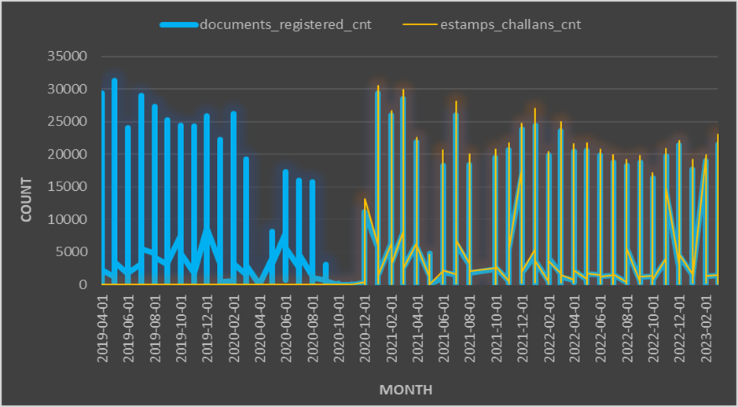
There has been a noticeable change in the pattern of e-Stamp challan count and document registration count since the introduction of e-Stamp challan. The visualizations have revealed significant changes in the pattern of e-Stamp challan count and document registration count since the implementation of e-Stamp challan. These findings suggest that the government should delve deeper into this matter to understand the cause behind this shift and make informed decisions based on these insights.

Slide 6
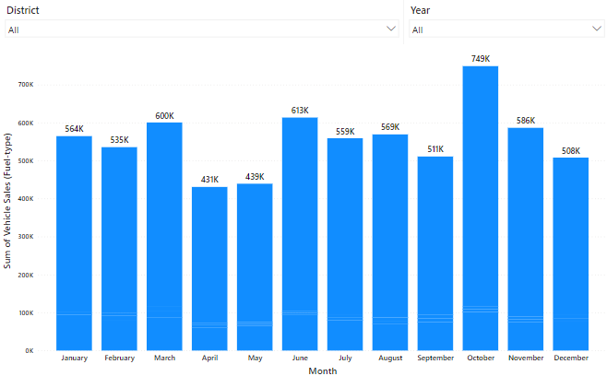
Correlation between vehicle sales and months

Slide 7
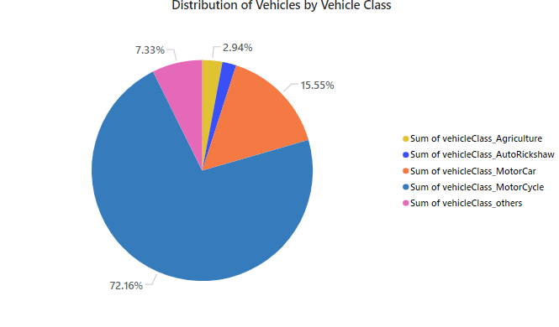
Distribution of Vehicles by Vehicle Class FY 2022

Slide 8
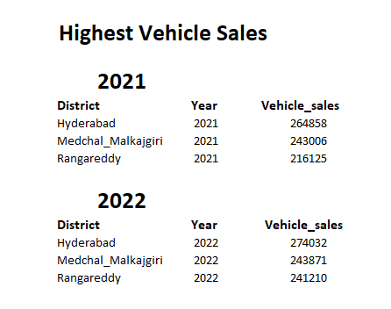
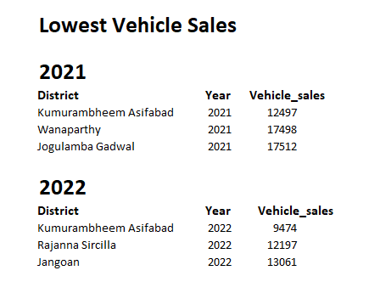
Top 3 and Bottom 3 Districts that have shown the highest and lowest vehicle sales growth during FY 2022 compared to FY 2021 (categories: Petrol, Diesel and Electric)

Slide 9
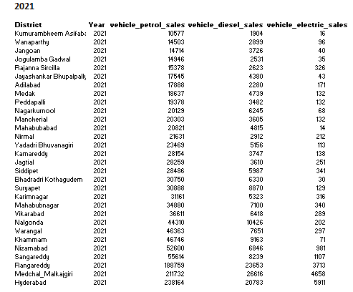
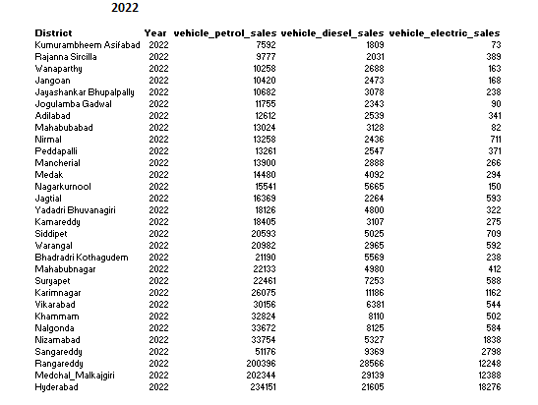
FY 2021 and FY 2022 Vehicle Sales across all Districts (Fuel-type)

Slide 10
The top 5 sectors that have witnessed the most significant investments in FY 2022
sector | Year | total_investments
Real Estate, Industrial Parks and IT Buildings | 2022 | ₹ 39,90,25,22,000
Plastic and Rubber | 2022 | ₹ 36,99,11,97,000
Pharmaceuticals and Chemicals | 2022 | ₹ 26,49,12,94,000
Solar and Other Renewable Energy | 2022 | ₹ 22,01,59,80,000
Beverages | 2022 | ₹ 18,48,19,20,000

Slide 11
The top 3 districts that have attracted the most significant sector investments during FY 2019 to 2022
dist_code | district | total_sector_investments
15_1 | Rangareddy | ₹ 4,09,84,27,59,000
15_2 | Medchal_Malkajgiri | ₹ 99,87,25,29,000
17_2 | Sangareddy | ₹ 89,55,40,81,000

Slide 12
Investments, vehicles sales and stamps revenue within the same district between FY 2021 and 2022
dist_code | district | total_investments | total_Vehicle_sales | total_estamps_revenue
19_1 | Adilabad | ₹ 10,85,20,000 | ₹ 16,85,843 | ₹ 19,94,49,18,144
22_2 | Bhadradri Kothagudem | ₹ 10,31,04,00,000 | ₹ 30,26,988 | ₹ 14,78,42,31,480
21_1 | Hanumakonda | ₹ 1,83,81,65,000 | ₹ 0 | ₹ 0
16_1 | Hyderabad | ₹ 34,81,00,000 | ₹ 2,61,67,391 | ₹ 6,87,65,75,46,864
20_2 | Jagtial | ₹ 91,06,16,000 | ₹ 24,22,145 | ₹ 28,86,28,30,992
21_3 | Jangoan | ₹ 1,00,96,38,000 | ₹ 14,96,104 | ₹ 20,22,92,61,360
21_7 | Jayashankar Bhupalpally | ₹ 18,79,16,000 | ₹ 0 | ₹ 0
14_2 | Jogulamba Gadwal | ₹ 1,12,25,65,000 | ₹ 14,91,545 | ₹ 17,02,42,64,472
18_2 | Kamareddy | ₹ 10,82,73,26,000 | ₹ 25,41,901 | ₹ 23,58,04,90,632
20_1 | Karimnagar | ₹ 2,64,18,66,000 | ₹ 35,70,449 | ₹ 71,73,75,92,520
22_1 | Khammam | ₹ 3,66,89,90,000 | ₹ 46,94,266 | ₹ 1,00,99,75,52,832
19_4 | Kumurambheem Asifabad | ₹ 20,13,92,000 | ₹ 10,33,436 | ₹ 3,49,66,18,848
21_5 | Mahabubabad | ₹ 1,13,86,61,000 | ₹ 19,88,194 | ₹ 18,70,55,19,504
14_1 | Mahabubnagar | ₹ 20,30,88,49,000 | ₹ 32,94,512 | ₹ 53,68,60,90,368
19_3 | Mancherial | ₹ 1,92,63,67,000 | ₹ 19,37,951 | ₹ 29,92,46,98,344
17_1 | Medak | ₹ 19,91,72,68,000 | ₹ 20,33,831 | ₹ 30,01,33,99,272
15_2 | Medchal_Malkajgiri | ₹ 54,28,40,12,000 | ₹ 2,01,78,314 | ₹ 8,40,48,16,80,528
21_6 | Mulugu | ₹ 26,26,93,000 | ₹ 0 | ₹ 0
14_3 | Nagarkurnool | ₹ 3,12,91,16,000 | ₹ 22,53,415 | ₹ 23,54,22,32,736
23_1 | Nalgonda | ₹ 14,01,48,12,000 | ₹ 46,84,584 | ₹ 72,22,31,41,776
14_5 | Narayanpet | ₹ 15,17,73,80,000 | ₹ 0 | ₹ 0
19_2 | Nirmal | ₹ 55,81,94,000 | ₹ 19,43,779 | ₹ 16,97,53,22,712
18_1 | Nizamabad | ₹ 1,27,69,58,000 | ₹ 47,80,276 | ₹ 73,13,02,79,304
20_4 | Peddapalli | ₹ 90,51,60,000 | ₹ 18,47,147 | ₹ 30,50,56,52,040
20_3 | Rajanna Sircilla | ₹ 84,18,92,000 | ₹ 14,39,046 | ₹ 19,81,36,96,896
15_1 | Rangareddy | ₹ 1,39,26,95,18,000 | ₹ 1,06,64,962 | ₹ 1,09,57,59,05,928
17_2 | Sangareddy | ₹ 60,04,47,70,000 | ₹ 62,49,073 | ₹ 4,00,99,72,70,520
17_3 | Siddipet | ₹ 13,21,71,53,000 | ₹ 29,30,309 | ₹ 46,74,10,17,744
23_2 | Suryapet | ₹ 14,14,68,84,000 | ₹ 33,28,728 | ₹ 50,22,94,86,528
15_3 | Vikarabad | ₹ 1,54,83,07,000 | ₹ 38,18,562 | ₹ 23,89,00,48,368
14_4 | Wanaparthy | ₹ 3,96,87,09,000 | ₹ 14,43,182 | ₹ 19,92,46,48,752
21_2 | Warangal | ₹ 1,27,01,57,000 | ₹ 37,63,995 | ₹ 11,62,71,59,184
23_3 | Yadadri Bhuvanagiri | ₹ 18,14,96,54,000 | ₹ 25,07,309 | ₹ 1,02,10,53,24,240

Slide 13
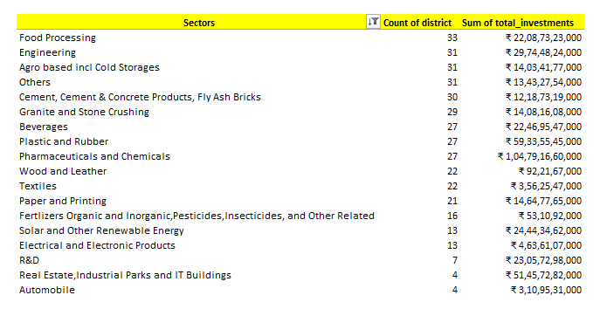
Sectors that have shown substantial investment in multiple districts between FY 2021 and 2022

Slide 14
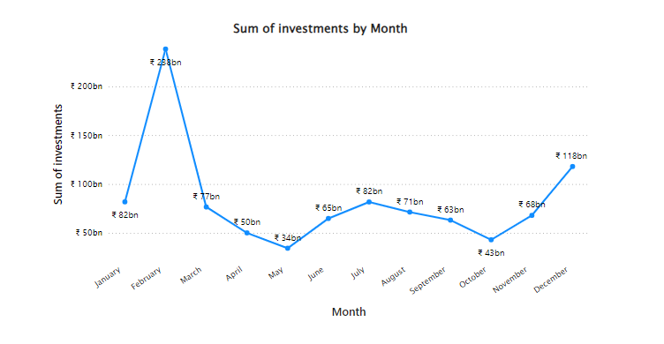
Investment trends FY 2019 – FY 2022

Slide 15
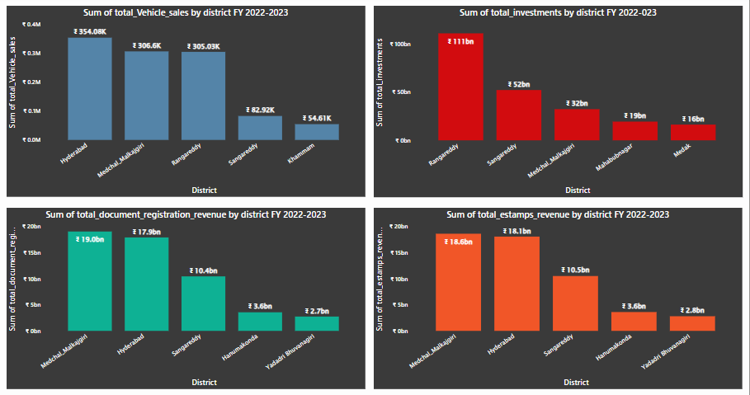
The Top 5 Districts FY 2022-2023

Slide 16
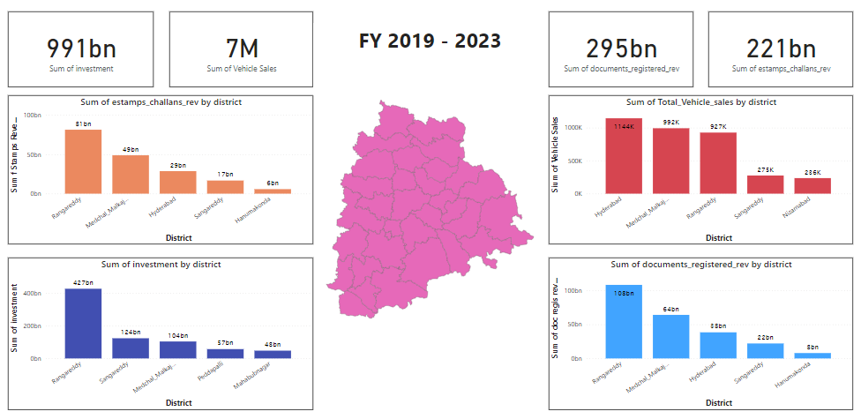
Telangana Growth Analysis Dashboard

Slide 17


THANK YOU!
vinaykumarpb4@gmail.com vinay-kumar-pb

